Slide 1


“Advanced C Programming”
eDESD-2021

Slide 2
File I/O

Slide 3
1. Introduction
Data files
  Can be created, updated, and processed by C programs
  Are used for permanent storage of large amounts of data
    Storage of data in variables and arrays is only temporary

Slide 4
2. The Data Hierarchy
Data Hierarchy:
  Bit – smallest data item
      Value of 0 or 1
  Byte – 8 bits
      Used to store a character
  Decimal digits, letters, and special symbols
  Field – group of characters conveying meaning
      Example: your name
  Record – group of related fields
      Represented by a struct or a class
Example: In a payroll system, a record for a particular employee that contained his/her identification number, name, address, etc.

Slide 5
2. The Data Hierarchy…
Data Hierarchy (continued):
  File – group of related records
    Example: Employee information file
  Database – group of related files
1
DSSD
2
DAC
3
WiMC
File
4
DESD
5
DASS
1
DSSD
Record
1
Field
00000001
Byte (Stores 1)
1
Bit

Slide 6
2. The Data Hierarchy…
Data files
  Record key
    Identifies a record to facilitate the retrieval of specific records from a file
  Sequential file
    Records typically sorted by key

Slide 7
3. Files and Streams
C views each file as a sequence of bytes
  File ends with the end-of-file (EOF) marker, Or, file ends at a specified byte.
Stream created when a file is opened
  Provide communication channel between files and programs
  Opening a file returns a pointer to a FILE
    Example file pointers:
      stdin - standard input (keyboard)
      stdout - standard output (screen)
      stderr - standard error (screen)

Slide 8
3. Files and Streams…
FILE structure
  File descriptor
    Index into operating system array called the open file table

Slide 9
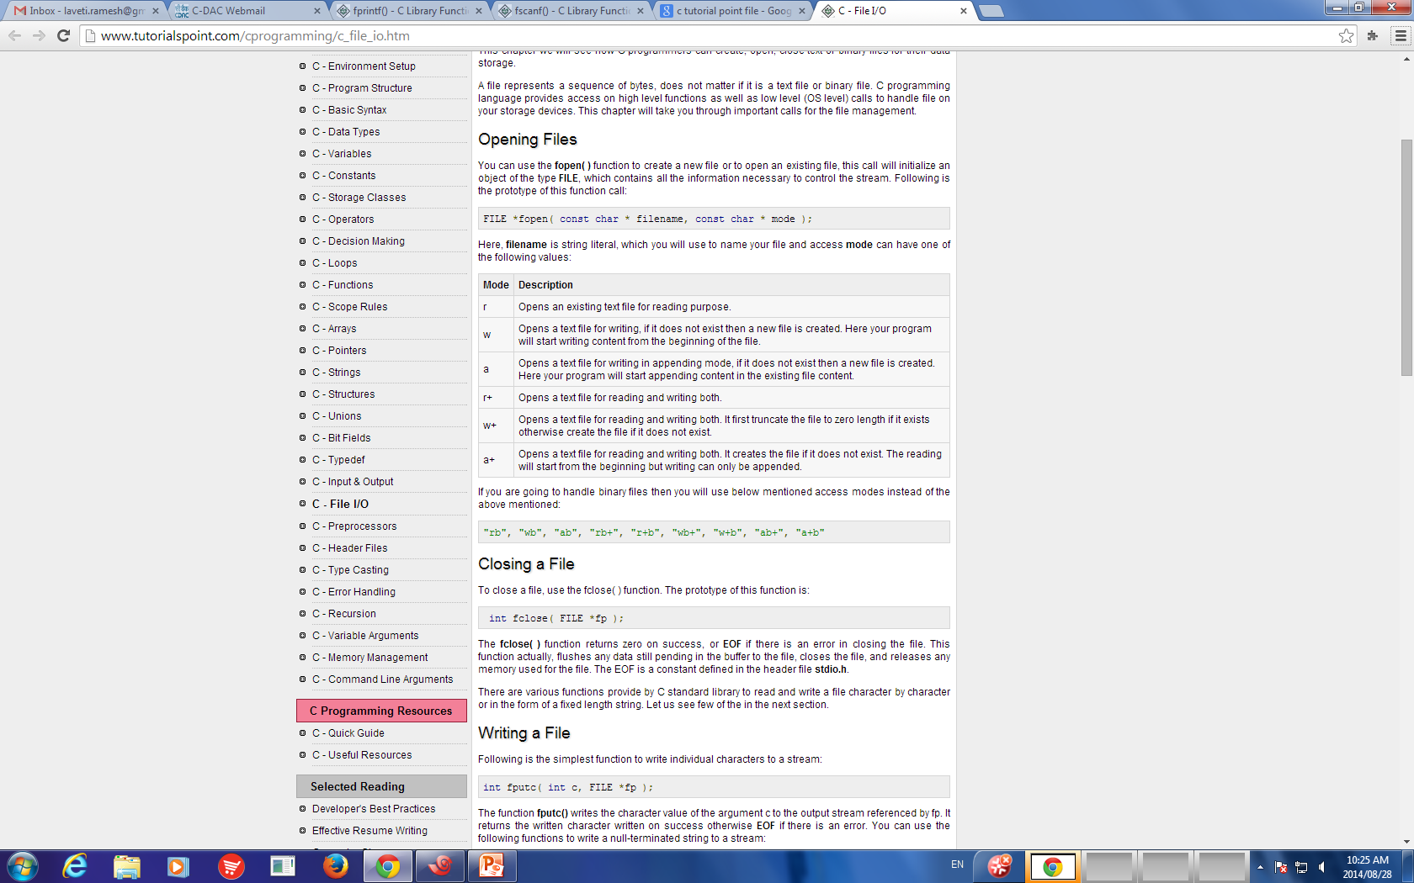
3. Files and Streams…
Table of file open modes:

Slide 10
3. Files and Streams…
Table of file open modes:
Mode | Operation | Description
r | Reading | Existing File
w | Writing | Truncate to zero length if file exists, Otherwise it creates a new file and writes from the beginning.
a | Append | Opens existing file if it exists, Otherwise it creates a new file and write from the end.
r+ | Reading Writing | Opens an existing file only, and can read or write.
w+ | Reading Writing | Existing file if exists. Otherwise it creates a new file. Writes from the beginning
a+ | Reading Appending | Existing file if exists. Otherwise it creates a new file. Writes from the end.

Slide 11
3. Files and Streams…
Read/Write functions in standard library
  fopen - FILE *fopen(const char *filename, const char *mode)
    opens the filename pointed to by filename using the given mode.
    Example:
      FILE * fp;
      fp = fopen ("file.txt", "w+");
    Arguments:
      filename -- This is the C string containing the name of the file to be opened.
      mode -- This is the C string containing a file access mode.
    Return Value: This function returns a FILE pointer. Otherwise, NULL is returned.

Slide 12
3. Files and Streams…
Read/Write functions in standard library
  fclose - int fclose(FILE *stream)
    Closes the stream. All buffers are flushed.
    Example:
      FILE * fp;
      fclose(fp);
    Arguments:
      stream -- This is the pointer to a FILE object that specifies the stream to be closed.
    Return Value: This method returns zero if the stream is successfully closed. On failure, EOF is returned.

Slide 13
3. Files and Streams…
Read/Write functions in standard library
  fgetc - c = fgetc(fp);
    int fgetc(FILE *stream)
    Gets the next character from the specified stream and advances the pointer to the next character in the stream.
    Reads one character from a file
    Takes a FILE pointer as an argument
    Return Value: character read or EOF
    fgetc(stdin) equivalent to getchar() & scanf(“%c”, &c)

Slide 14
3. Files and Streams…
Read/Write functions in standard library
  fputc - fputc(ch, fp);
    Declaration: int fputc(int char, FILE *stream)
    Parameters:
      char -- This is character to be written. This is passed as its int promotion.
      stream -- This is the pointer to a FILE object that identifies the stream where the character is to be written.
      Return Value -- If there are no errors, the same character that has been written is returned.If an error occurs, EOF is returned and the error indicator is set.
    fputc( 'a', stdout ) equivalent to putchar( 'a' )

Slide 15
3. Files and Streams…
Read/Write functions in standard library
  fgets
    Declaration: char *fgets(char *str, int n, FILE *stream)
    Reads a line from a file till the EOF or n characters are read
    Arguments
      str - array of chars where the string read is stored.
      n -- This is the maximum number of characters to be read (including the final null-character)
      stream -- This is the pointer to a FILE object
    Return Value - On success, the function returns the same str parameter. If Error, NULL pointer is retured

Slide 16
3. Files and Streams…
Read/Write functions in standard library
  fputs - int fputs(const char *str, FILE *stream)
    Writes a string to the specified stream
    Arguments
      str -- This is an array containing the null-terminated sequence of characters to be written.
      stream -- This is the pointer to a FILE object that identifies the stream
    Return Value - This function returns a non-negative value else, on error it returns EOF.

Slide 17
3. Files and Streams…
Read/Write functions in standard library
  fprintf - int fprintf(FILE *stream, const char *format, ...)
    File processing equivalents of printf
    Sends formatted output to a stream.
    Arguments:
      stream -- This is the pointer to a FILE object that identifies the stream.
      format – Format specifiers
    Return Value:
      If successful, the total number of characters written is returned otherwise, a negative number is returned.

Slide 18
3. Files and Streams…
Read/Write functions in standard library
  fscanf - int fprintf(FILE *stream, const char *format, ...)
    File processing equivalents of scanf
    Reads formatted input from a stream.
    Arguments:
      stream -- This is the pointer to a FILE object that identifies the stream.
      format – Format specifiers
    Return Value:
      This function return the number of input items successfully matched and assigned, which can be fewer than provided for, or even zero in the event of an early matching failure.

Slide 19
4. Creating a Sequential Access File
Creating a File
  FILE *myPtr;
    Creates a FILE pointer called myPtr
  myPtr = fopen("myFile.dat", openmode);
    Function fopen returns a FILE pointer to file specified
    Takes two arguments – file to open and file open mode
    If open fails, NULL returned
  fprintf
    Used to print to a file
    Like printf, except first argument is a FILE pointer (pointer to the file you want to print in)

Slide 20
4. Creating a Sequential Access File…
  feof( FILE pointer )
    Returns true if end-of-file indicator (no more data to process) is set for the specified file
  fclose( FILE pointer )
    Closes specified file
    Performed automatically when program ends
    Good practice to close files explicitly
Details
  Programs may process no files, one file, or many files
  Each file must have a unique name and should have its own pointer

Slide 21
4. Creating a Sequential Access File…
  feof( FILE pointer )
    Returns true if end-of-file indicator (no more data to process) is set for the specified file
  fclose( FILE pointer )
    Closes specified file
    Performed automatically when program ends
    Good practice to close files explicitly
Details
  Programs may process no files, one file, or many files
  Each file must have a unique name and should have its own pointer

Slide 22
File reading - fgetc
  #include <stdio.h>
  int main ()
  {
  //Declare a file pointer
  FILE *fp;
  char c;
  //Open the file and check whether the file is opened or not
  fp = fopen ("file1.txt", "r");
  if (fp == NULL)
  {
  perror ("Error in opening file");
  return (-1);
  }
  //Read characters from files and print to stdout
  do
  {
  c = fgetc (fp);
  if (c == EOF)
  {
  break;
  }
  fputc (c, stdout);
  }
  while (1);
  //Close the file
  fclose (fp);
  return (0);
  }

Slide 23
File reading - fgets
  #include <stdio.h>
  int main()
  {
  FILE *fp;
  char str[60];
  /* opening file for reading */
  fp = fopen("file2.txt" , "r");
  if(fp == NULL)
  {
  perror("Error opening file");
  return(-1);
  }
  while (1)
  {
  if (fgets (str, 60, fp) != NULL)
  {
  /* writing content to stdout */
  // puts(str);
  fputs (str, stdout);
  }
  else
  break;
  }
  fclose (fp);
  return (0);
  }

Slide 24
File writing and reading – fptus and fgets
  #include <stdio.h>
  int main ()
  {
  FILE *fp;
  char str[60];
  fp = fopen("file3.txt", "w+");
  fputs("This is c programming.\n", fp);
  fputs("This is a system programming language.", fp);
  //after this fp points to the end of th file
  rewind(fp); //fp points to the beginning of the file
  while(1)
  {
  if( (fgets(str, 60, fp)) == NULL)
  {
  // printf("Error in reeading\n");
  break;
  }
  else
  printf("%s\n", str);
  // fputs(str, stdout);
  }
  fclose(fp);
  return(0);
  }

Slide 25
File reading - fscanf
  #include <stdio.h>
  #include <stdlib.h>
  int main()
  {
  char str1[40], str2[40], str3[40];
  int year;
  FILE * fp;
  fp = fopen ("file4.txt", "w+");
  fputs("We are in 2020\n", fp);
  fputs("We are in 2021", fp);
  rewind(fp);
  fscanf(fp, "%[^\n]s", str1);
  printf("Read String1: %s\n", str1 );
  fscanf(fp, "%s %s %s %d", str1, str2, str3, &year);
  printf("Read String1: %s\n", str1 );
  printf("Read String2: %s\n", str2 );
  printf("Read String3: %s\n", str3 );
  printf("Read Integer: %d\n", year );
  fclose(fp);
  return(0);
  }

Slide 26
1
2 /* Create a sequential file */
3 #include <stdio.h>
4
1. Initialize variables and FILE pointer
1.1 Link the pointer to a file
2. Input data
2.1 Write to file (fprintf)
3. Close file
5 int main()
6 {
7 int account;
8 char name[ 30 ];
9 double balance;
10 FILE *cfPtr; /* cfPtr = clients.dat file pointer */
11
12 if ( ( cfPtr = fopen( "clients.dat", "w" ) ) == NULL )
13 printf( "File could not be opened\n" );
14 else {
15 printf( "Enter the account, name, and balance.\n" );
16 printf( "Enter EOF to end input.\n" );
17 printf( "? " );
18 scanf( "%d%s%lf", &account, name, &balance );
19
20 while ( !feof( stdin ) ) {
21 fprintf( cfPtr, "%d %s %.2f\n",
22 account, name, balance );
23 printf( "? " );
24 scanf( "%d%s%lf", &account, name, &balance );
25 }
26
27 fclose( cfPtr );
28 }
29
30 return 0;
31 }

Slide 27
Enter the account, name, and balance.
Enter EOF to end input.
? 100 Jones 24.98
? 200 Doe 345.67
? 300 White 0.00
? 400 Stone -42.16
? 500 Rich 224.62
?
Program Output

Slide 28
5. Reading Data from a Sequential Access File
Reading a sequential access file
  Create a FILE pointer, link it to the file to read
    myPtr = fopen( "myFile.dat", "r" );
  Use “fscanf” to read from the file
    Like scanf, except first argument is a FILE pointer
    fscanf( myPtr, "%d%s%f", &myInt, &myString, &myFloat );
  Data read from beginning to end
  File position pointer
    Indicates number of next byte to be read / written
    Not really a pointer, but an integer value (specifies byte location), Also called byte offset
  rewind( myPtr )
    Repositions file position pointer to beginning of file (byte 0)

Slide 29
2 /* Reading and printing a sequential file */
3 #include <stdio.h>
4
5 int main()
1. Initialize variables
1.1 Link pointer to file
2. Read data (fscanf)
2.1 Print
3. Close file
Program Output
6 {
7 int account;
8 char name[ 30 ];
9 double balance;
10 FILE *cfPtr; /* cfPtr = clients.dat file pointer */
11
12 if ( ( cfPtr = fopen( "clients.dat", "r" ) ) == NULL )
13 printf( "File could not be opened\n" );
14 else {
15 printf( "%-10s%-13s%s\n", "Account", "Name", "Balance" );
16 fscanf( cfPtr, "%d%s%lf", &account, name, &balance );
17
18 while ( !feof( cfPtr ) ) {
19 printf( "%-10d%-13s%7.2f\n", account, name, balance );
20 fscanf( cfPtr, "%d%s%lf", &account, name, &balance );
21 }
22
23 fclose( cfPtr );
24 }
25
26 return 0;
27 }
Account Name Balance
100 Jones 24.98
200 Doe 345.67
300 White 0.00
400 Stone -42.16
500 Rich 224.62

Slide 30
1
2 /* Credit inquiry program */
3 #include <stdio.h>
4
1. Initialize variables
2. Open file
2.1 Input choice
2.2 Scan files
3. Print
5 int main()
6 {
7 int request, account;
8 double balance;
9 char name[ 30 ];
10 FILE *cfPtr;
11
12 if ( ( cfPtr = fopen( "clients.dat", "r" ) ) == NULL )
13 printf( "File could not be opened\n" );
14 else {
15 printf( "Enter request\n"
16 " 1 - List accounts with zero balances\n"
17 " 2 - List accounts with credit balances\n"
18 " 3 - List accounts with debit balances\n"
19 " 4 - End of run\n? " );
20 scanf( "%d", &request );
21
22 while ( request != 4 ) {
23 fscanf( cfPtr, "%d%s%lf", &account, name,
24 &balance );
25
26 switch ( request ) {
27 case 1:
28 printf( "\nAccounts with zero "
29 "balances:\n" );
30
31 while ( !feof( cfPtr ) ) {
32

Slide 31
33 if ( balance == 0 )
34 printf( "%-10d%-13s%7.2f\n",
35 account, name, balance );
36
2.2 Scan files
3. Print
37 fscanf( cfPtr, "%d%s%lf",
38 &account, name, &balance );
39 }
40
41 break;
42 case 2:
43 printf( "\nAccounts with credit "
44 "balances:\n" );
45
46 while ( !feof( cfPtr ) ) {
47
48 if ( balance < 0 )
49 printf( "%-10d%-13s%7.2f\n",
50 account, name, balance );
51
52 fscanf( cfPtr, "%d%s%lf",
53 &account, name, &balance );
54 }
55
56 break;
57 case 3:
58 printf( "\nAccounts with debit "
59 "balances:\n" );
60
61 while ( !feof( cfPtr ) ) {
62
63 if ( balance > 0 )
64 printf( "%-10d%-13s%7.2f\n",

Slide 32
65 account, name, balance );
66
67 fscanf( cfPtr, "%d%s%lf",
68 &account, name, &balance );
3.1 Close file
69 }
70
71 break;
72 }
73
74 rewind( cfPtr );
75 printf( "\n? " );
76 scanf( "%d", &request );
77 }
78
79 printf( "End of run.\n" );
80 fclose( cfPtr );
81 }
82
83 return 0;
84 }

Slide 33
Enter request
1 - List accounts with zero balances
2 - List accounts with credit balances
3 - List accounts with debit balances
4 - End of run
? 1
Accounts with zero balances:
300 White 0.00
? 2
Accounts with credit balances:
400 Stone -42.16
? 3
Accounts with debit balances:
100 Jones 24.98
200 Doe 345.67
500 Rich 224.62
? 4
End of run.
Program Output

Slide 34
Binary file reading and writing
#include <stdio.h>
struct s
{
char name[50];
int height;
};
int main(){
struct s a,b;
FILE *fptr;
int i;
fptr=fopen("file.txt","wb");
for(i=0;i<5;++i)
{
//fflush(stdin);
printf("Enter name: ");
scanf("%s",a.name);
printf("Enter height: ");
scanf("%d",&a.height);
fwrite(&a,sizeof(a),1,fptr);
}
fclose(fptr);
fptr=fopen("file.txt","rb");
while(1)
{
if(fread(&b,sizeof(b),1,fptr)==1)
printf("Name: %s Height: %d\n",b.name,b.height);
else
break;
}
fclose(fptr);
}

Slide 35
fseek()
fseek
  Sets file position pointer to a specific position
  fseek( FILE *fp, offset, whence);
    pointer – pointer to file
    offset – Number of bytes to offset from whence
    whence – Position from where offset is added
      SEEK_SET – seek starts at beginning of file
      SEEK_CUR – seek starts at current location in file
      SEEK_END – seek starts at end of file

Slide 36
Thank You

